Slide 1

COVID-19 Vaccine Hesitancy
Kim Lanaghen, Chang Ni, Abbey Marye, Sandi Alshahwan, and Clara Garcia

Slide 2
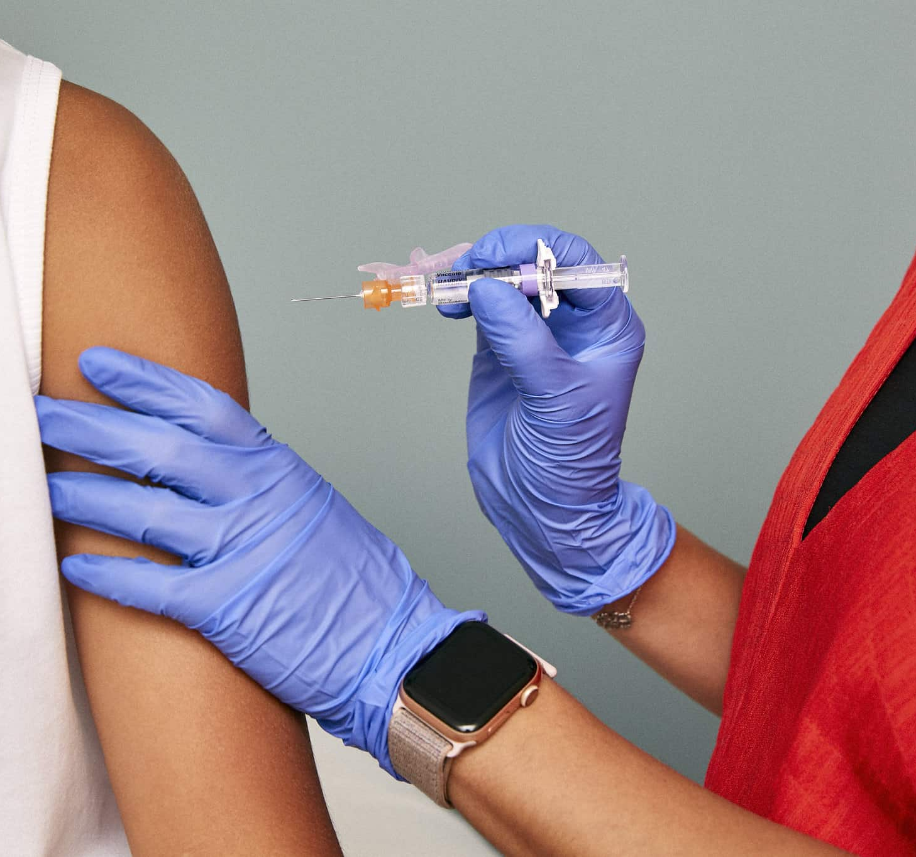
Background and Motivation
Attitudes toward COVID-19 and its vaccine have been contested since its rollout in early 2021.
From the early stages of the COVID-19 pandemic in 2020, public responses have varied widely across geographic regions
Media has provoked differences in risk perception, trust in public guidance, and personal health beliefs.
Using both survey and numerical data to examine how collective beliefs and individual choices we will have a measurable effect on population outcomes.
By linking opinion data to epidemiological trends, this project highlights how vaccine acceptance coincides with community health and well-being.
Aim to underscore the importance of reliable information dissemination and evidence-based decision-making without making assumptions beyond what the data can support.
This Photo by Unknown Author is licensed under CC BY-ND

Slide 3
Questions
Is there data complete enough to create a new dataset to derive meaningful insights from?
Is there a measurable correlation between vaccine attitudes and weekly COVID-19 death rates across U.S. states and counties?
How do these relationships vary geographically and over different phases of the pandemic?
Do Social Determinates of Health exhibit any correlation to either vaccine sentiments?
Do regions with consistently lower vaccine acceptance exhibit different mortality trends compared to regions with high acceptance?

Slide 4
Objectives
Answer whether individual vaccine attitudes, at a state or county level, correlate to COVID-19 death rates within a reasonable time frame (2020-2022).
To learn how individual health decisions and/or social determinants of health can affect community health on a large scale, and how this applies to disinformation, health information policy, and incentives to make well-informed decisions.
To aggregate and clean data to answer further meaningful questions about COVD-19 vaccine hesitancy, SDOH, and outcomes
Brief analysis to observe any correlations or statistical significance between vaccine hesitancy, SDOH, and county death rates.

Slide 5
Data Sources
For our project, we will use three datasets. One captures vaccine attitudes, the second COVID-19 mortality trends, and the third SDOH by county from 2017-2021.
Vaccine Hesitancy (taken 5/27/2021-6/7/2021): https://www.kaggle.com/code/jaykumar1607/covid-vaccine-hesitancy-usa-plotly-mapbox/notebook#Demographics
Weekly death counts by State: https://data.cdc.gov/Case-Surveillance/Weekly-United-States-COVID-19-Cases-and-Deaths-by-/pwn4-m3yp/about_data
Social Determinants of Health by County (2017-2021):
https://catalog.data.gov/dataset/sdoh-measures-for-county-acs-2017-2021

Slide 6
Data Merge
Step 1: Merge Hesitancy + Death Data
Matched 3,140 US counties by FIPS code
Converted raw death counts → death rates per 100,000 population
Created both weekly and cumulative versions
Step 2: Add SDOH Measures
Added 9 social determinants of health indicators
Final dataset: 3,140 counties × 178 columns
SDOH Measures Included：
Poverty rate, No broadband internet access, No high school diploma,
Unemployment rate, Single-parent households, Housing cost burden,
Crowding, Aged 65+, Racial/ethnic minority status

Slide 7
Data Quality Assessment
Based on Weiskopf and Weng Framework

Slide 8
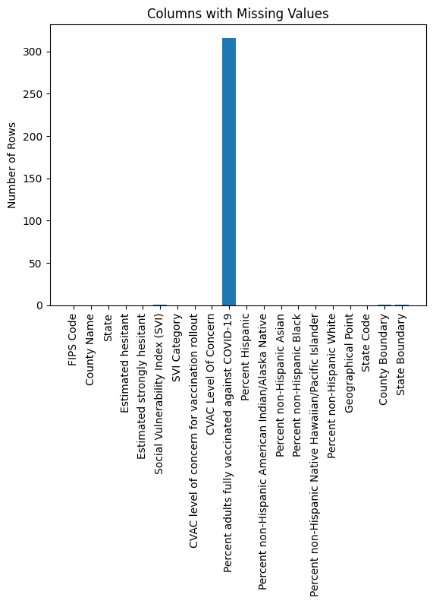
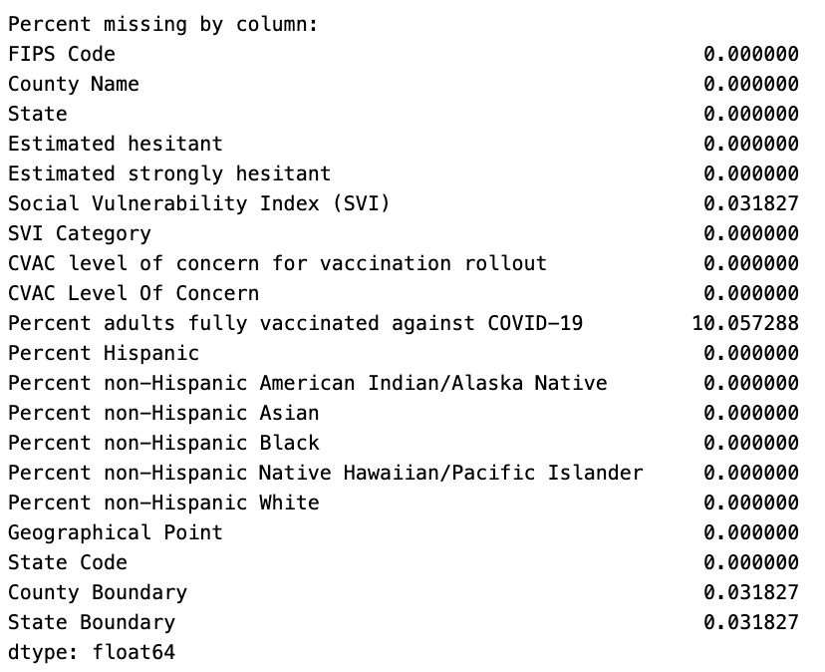
Completeness

Slide 9
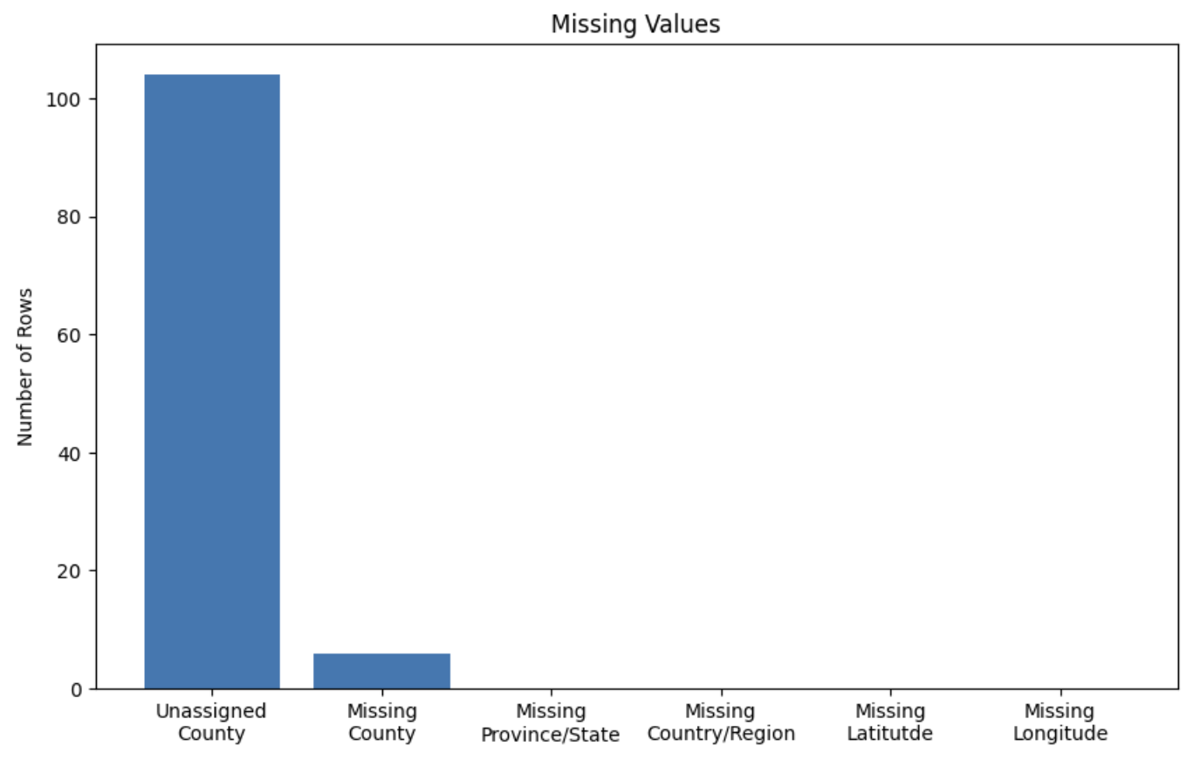
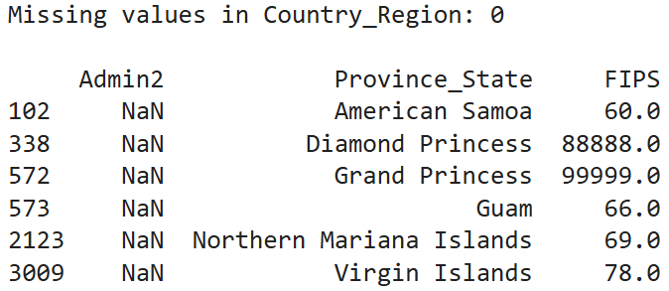
Completeness COVID-19 Deaths
Overall completeness: 99.9995%
Only 10 rows missing FIPS
6 missing county names (Admin2)
Notes:
Considerations for completeness:
-identify missing counties, do those need to be excluded from the analysis?
-missing FIPS, we used FIPS to combine the datasets

Slide 10
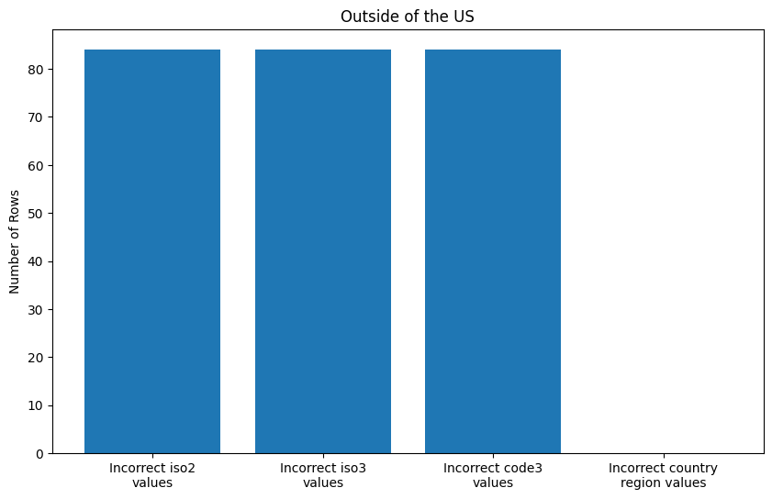
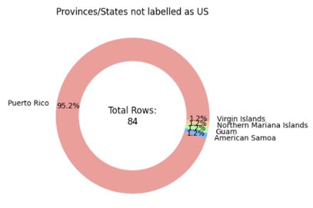
Correctness COVID-19 Deaths
Notes:
-84 incorrect iso2, iso3, and code3 values correspond to rows for territories
-iso's are country code identifiers

Slide 11
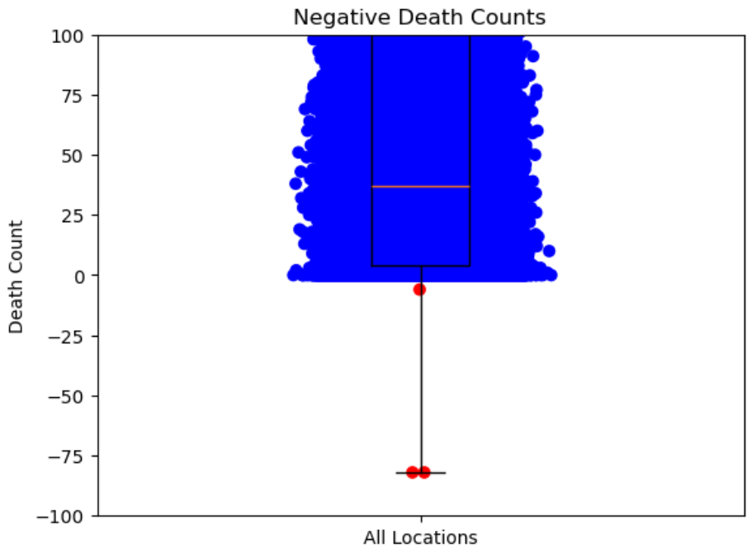
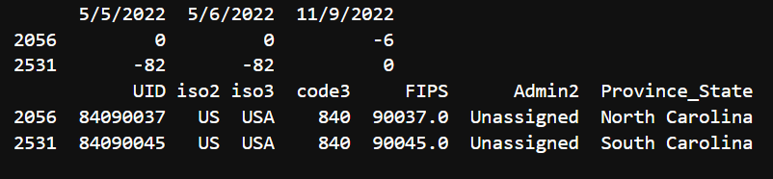
Correctness COVID-19 Deaths
Data modification records indicate:
"March 19, 2021: North Carolina, US | Removal of 99 deaths that did not fit the most recent version of the state definition of a COVID-19 death"(Johns Hopkins University CSSE, 2021).
The cause of the South Carolina correction is unknown. No specific documentation was found in the JHU CSSE modification records.
Notes:
-there are 3 instances of negative death counts, for rows 2056 and 2531 (located in North and South Carolina respectively)
-changes are likely due to data modifications, for example is COVID-19 death definitions changed, data entry error, etc.

Slide 12
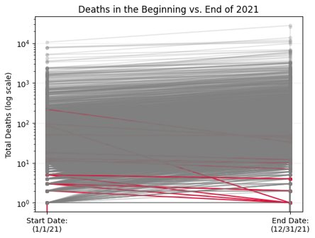
Concordance
FIPS Codes checked to be 5 digits
Cumulative COVID-19 death count is not expected to decrease over time
No COVID-19 deaths before 2020
Counties where end of 2021 death count is less than at the start of 2021: 15
Notes:
Concordance: expected values, does the data agree with other sources or internal logic?

Slide 13
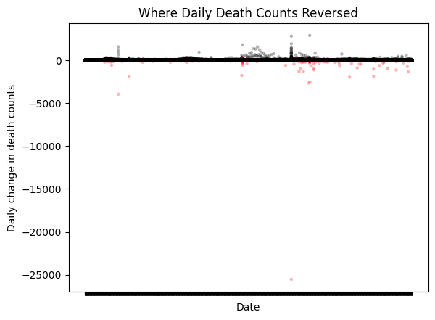
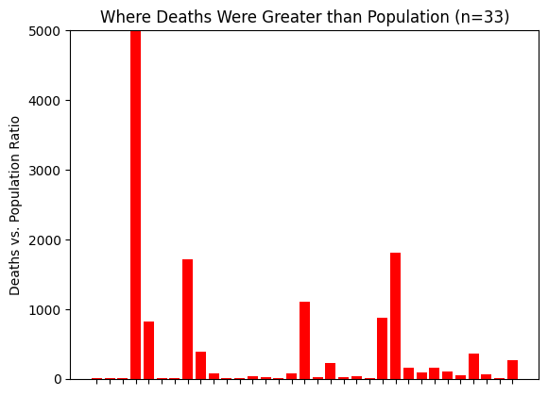
Concordance
Notes:
-The first graphs show anomalies in death counts
-once a death count is recorded it is not expected to disappear. However, there was a long list of data modifications recorded
- the filed corrections were large enough to lower the cumulative total

Slide 14
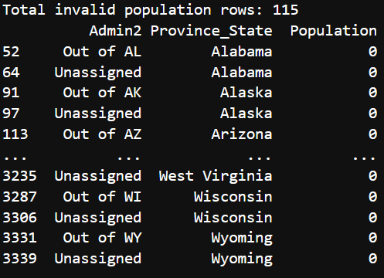
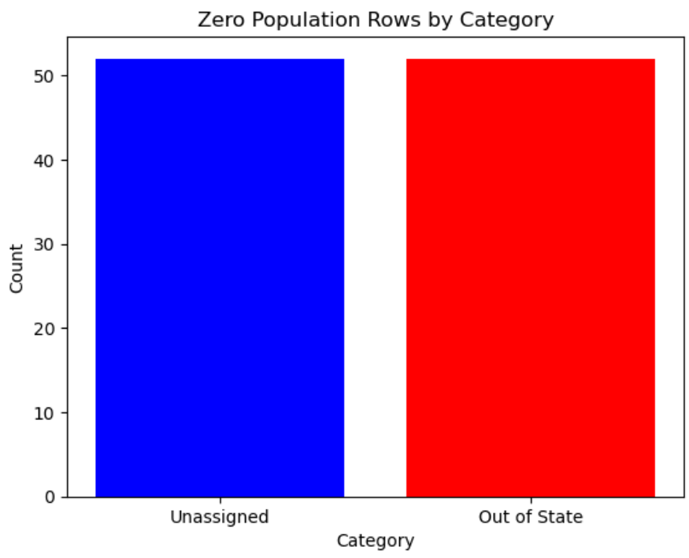
Plausibility
No counties with less than 100,000 deaths
115 rows with zero population were identified
Correspond to 'Unassigned' and 'Out of State' placeholders rather than real locations, and are expected to have no population value
Notes:
-100,000 deaths in a single county would be implausible
-"Out of state" = deaths that occurred outside specific state but were reported by that state, e.g. Alabama
-"Unassigned" = deaths not yet assigned to a specific county

Slide 15
Currency
COVID-19 deaths data was all up to date for 2021
Some states/territories stopped recording death counts before 2023
Notes:
-small states/territories might have limited public health infrastructure
-could have transitioned to federal reporting system
-we mostly cared for currency of 2021 since that is the year the vaccine was available (Vaccine was available at the end of 2020)

Slide 16
Results
Correlations between SDOH and Vaccine Hesitancy
Predictors:
Weak / not significant:
Poverty → +0.41
No broadband → +0.39
No high school diploma→ +0.28
Single-parent → +0.19
Unemployment → +0.16
Housing cost burden → -0.15
Age 65+ → -0.06
Minority status → +0.05
Crowding → +0.04
Notes:
We proceeded with a simple analysis to make sure that our dataset is actually working and producing meaningful relationships.
First, we looked at how social determinants relate to vaccine hesitancy.
We found that poverty, lack of broadband access, and lower education had the strongest positive associations with hesitancy.
Some variables showed weaker relationships, and others were not significant.
Overall, this suggests that socioeconomic disadvantage is associated with higher vaccine hesitancy.

Slide 17
Hesitancy and SDOH in Relation to Mortality
SDOH | Beta | R²
No broadband | +8.47 | 0.26
Poverty | +7.37 | 0.24
No high school diploma | +9.40 | 0.23
Age 65+ | +8.51 | 0.19
Hesitancy significant in all models
Betas show direction of association
R² shows model strength
Notes:
We then ran a series of regression models, each including hesitancy and one SDOH variable.
Hesitancy remained significant across all models.
Here, the beta values indicate the direction of association, while R-squared shows how much variation each model explains.
The strongest models included broadband access, poverty, education, and age, explaining about 19 to 26 percent of variation in mortality.

Slide 18
Conclusion
Successfully integrated multiple datasets (hesitancy, mortality, SDOH)
Performed data cleaning, harmonization, and quality checks
Created a consistent, county-level analytic dataset
Analysis showed meaningful relationships across variables
Dataset is ready for further analysis and interpretation
Notes:
Overall, this project focused on preparing and integrating multiple data sources into a usable dataset.
We worked through key data wrangling steps, including cleaning, harmonization, and combining datasets at the county level.
The analysis we conducted helped confirm that the data is producing meaningful and expected relationships between hesitancy, social determinants, and mortality.
Overall, this gives us confidence that the dataset is well-prepared and suitable for further analysis.

Slide 19
References
Centers for Disease Control and Prevention. (n.d.). Weekly United States COVID-19 cases and deaths by state. https://data.cdc.gov/Case-Surveillance/Weekly-United-States-COVID-19-Cases-and-Deaths-by-/pwn4-m3yp/about_data
ChangNandina. (n.d.). BMI6016_Group5. GitHub. https://github.com/ChangNandina/BMI6016_Group5
Johns Hopkins University Center for Systems Science and Engineering. (2021). COVID-19 data repository README. GitHub. https://github.com/CSSEGISandData/COVID-19/blob/master/csse_covid_19_data/README.md
Kumaravel, J. (2021). COVID vaccine hesitancy USA - Plotly & Mapbox [Data survey conducted May 27 – June 7, 2021]. Kaggle. https://www.kaggle.com/code/jaykumar1607/covid-vaccine-hesitancy-usa-plotly-mapbox/notebook
U.S. Department of Health and Human Services. (2021). SDOH measures for county ACS 2017-2021. Data.gov. https://catalog.data.gov/dataset/sdoh-measures-for-county-acs-2017-2021

